Slide 1


Spark Interview Questions Different Modes in Apache Spark

Slide 2
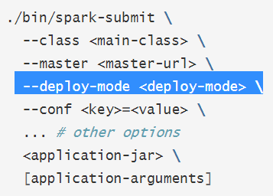
Deploy Modes In Spark
Whenever the spark application is executed on the cluster, there comes the concept of the deployment modes, job submit script gives you an option to define deploy mode.
Deployment Modes on the cluster in spark specifies where exactly the driver program will run.
Based on this, There are two kinds of deployment modes:
Spark cluster mode : driver program runs on the worker node inside the cluster.
Spark Client Mode : driver program runs on the external client.

Slide 3
Client Mode in Spark
Here, in the client mode “driver” component of spark job will run on the machine from which job is submitted.
Performance :
Network Overhead – As data needs to be moved between the Driver and the Worker nodes across the network between the submitting machine(driver machine) and the cluster, depending on the network latency there would be performance penalty.
Issues of disconnection, leading to job failure.
Spark Cluster
Job Submitting Machine
Cluster manager Container
Spark Cluster
Driver

Slide 4
Cluster Deploy Modes In Spark
Here, in this mode the Driver program would be launched inside the spark cluster itself, on any of the available node in the cluster.
Spark Cluster
Job Submitting Machine
Cluster manager Container
Worker Nodes
Driver

Slide 5
Cluster Deploy Modes In Spark
Benefits :
As in this mode driver program run with in the cluster ,this reduces the data movement overhead between the submitting machine and the cluster.
In this spark mode, the chance of network disconnection between driver and spark infrastructure reduces. as they reside in the same infrastructure(cluster), It highly reduces the chance of job failure.

Slide 6
Cluster Deploy Modes In Spark
Thanks for watching and do subscribe to the channel

